Slide 1
Pemrograman jaringan
Prodi s1 Teknik informatika
Institut teknologi sepuluh nopember

Slide 2
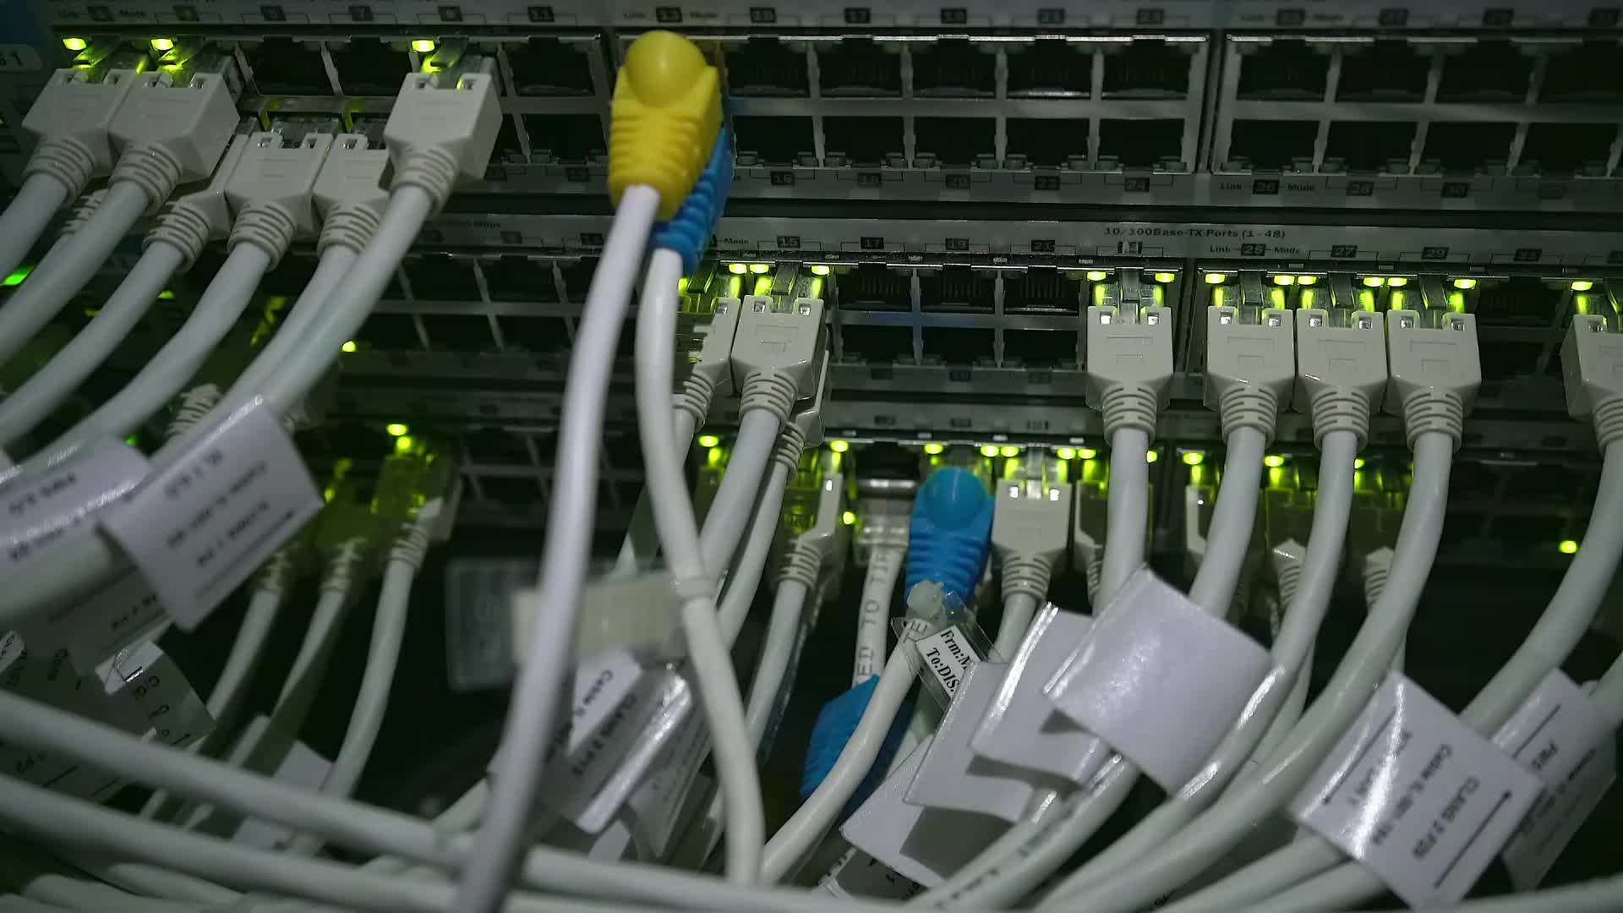
outline
Server menangani banyak klien
Select
Server
Klien
Poll
Tutorial Python
Read/write file
Debug dengan Wireshark
SocketServer

Slide 3
Modul Select
Menangani banyak klien dalam suatu waktu
Bergantian antara banyak klien yang terkoneksi
Menunggu pengiriman data satu klien, melayani klien yang lain
Diproses setelah salah satu socket selesai bertransaksi (read/write)
read == receive
write == send

Slide 4
Modul Select
select(rlist, wlist, xlist[,timeout])
rlist: wait until ready for reading
wlist: wait until ready for writing
xlist: wait for an “exceptional condition”
Docs: https://docs.python.org/3/library/select.html

Slide 5
Modul Poll
Mempunyai behavior yang mirip dengan select
Hanya berjalan di sistem operasi yang berbasis UNIX
Tidak bisa berjalan di Windows
Sehingga lebih jarang digunakan karena tidak cross-platform

Slide 6
Server dengan Select
create socket
bind
listen
make list for sockets
while running
select
accept and append to list
recv and send

Slide 7
klien
create socket
connect
while running
read input
send and recv
break if keyboard interrupt

Slide 8
Konsep klien-server: socket
Socket klien di sisi server → satu socket per koneksi
Disimpan dalam sebuah list
Socket server
Server
Socket klien 1
Klien 1
Socket klien 2
Klien 2
Klien 3
Keterangan:
Socket klien di server
Socket klien di klien
Socket klien 3

Slide 9
Contoh Server-Select (1)
Membuat socket, bind, listen
server_address = ('127.0.0.1', 5000)
server_socket = socket.socket(socket.AF_INET, socket.SOCK_STREAM)
server_socket.setsockopt(socket.SOL_SOCKET, socket.SO_REUSEADDR,1)
server_socket.bind(server_address)
server_socket.listen(5)
input_socket = [server_socket]
“Memaksa” address and port
untuk bisa digunakan
List untuk menampung socket

Slide 10
Konsep klien-server: socket
Perintah select mengecek socket yang ready
Jika ready, maka akan diproses secara bergantian
Socket server
Server
Socket klien 1
Klien 1
Socket klien 2
Klien 2
Klien 3
Keterangan:
Socket klien di server
Socket klien di klien
Socket klien 3

Slide 11
Contoh Server-Select (2)
Pengecekan apakah ada
socket input yang telah siap diproses
while True:
read_ready, write_ready, exception = select.select(input_socket, [], [])
for sock in read_ready:
if sock == server_socket:
client_socket, client_address = server_socket.accept()
input_socket.append(client_socket)
else:
data = sock.recv(1024)
print(sock.getpeername(), data)
if data:
sock.send(data)
else:
sock.close()
input_socket.remove(sock)
Jika socket yang siap adalah socket server,
maka accept() klien dan tambahkan ke list
Jika socket yang siap adalah socket klien, maka
terima data dan mengirimkannya kembali ke klien
Jika tidak ada data yang diterima, maka
tutup socket dan hapus socket dari list

Slide 12
Contoh Server-Select (2)
while True:
read_ready, write_ready, exception = select.select(input_socket, [], [])
for sock in read_ready:
if sock == server_socket:
client_socket, client_address = server_socket.accept()
input_socket.append(client_socket)
else:
data = sock.recv(1024)
print(sock.getpeername(), data)
if data:
sock.send(data)
else:
sock.close()
input_socket.remove(sock)
Select akan bergantian memproses socket yang siap
Di Windows, list input hanya bisa berisi socket
sedangkan di Linux,
list bisa berisi object yang lain

Slide 13
Link Source Code - Select
https://github.com/studiawan/network-programming
bab03
server-select.py
client-select.py

Slide 14
Read/Write File
https://github.com/studiawan/network-programming
bab02
write.py
write-with.py

Slide 15
Debug dengan Wireshark
Contoh program klien server sederhana
Server/Klien: https://github.com/studiawan/network-programming
bab03
Jalankan Wireshark dengan hak akses root dan monitor loopback interface
Jalankan program server
Jalankan program klien
Amati perubahan yang tercatat pada Wireshark

Slide 16
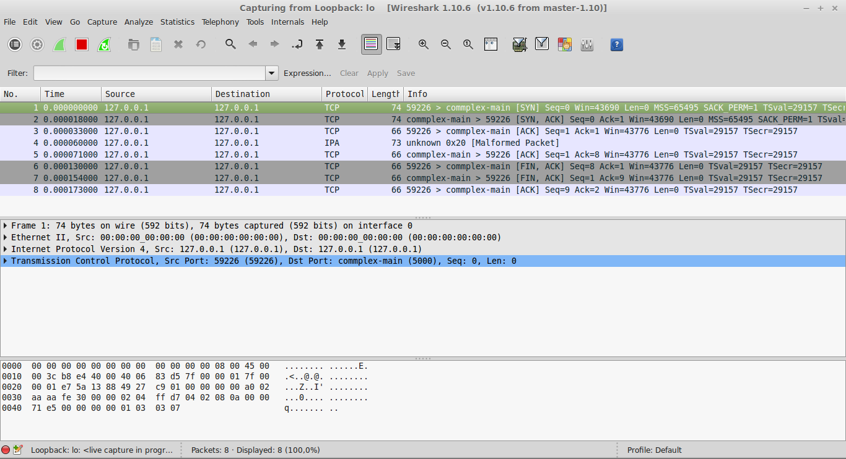
Tampilan Wireshark Ketika Klien Mengirim Pesan dan Menutup Koneksi

Slide 17
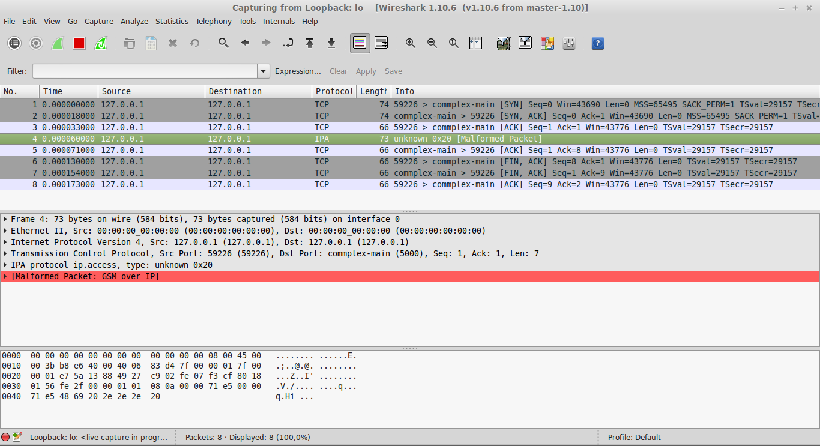
Tampilan pada Data yang Dikirim

Slide 18
Keterangan
Protokol IPA: "GSM over IP" protocol.
Protokol yang biasanya menggunakan port 3002, 3003, 3006, 4249, 4250, and 5000 di atas TCP
Malformed packet: paket tidak sesuai dengan protokol yang standar
Commplex-main: service name yang berasosiasi dengan port 5000 pada services file
Trafik ini bisa jadi merupakan service standar yang lain
Hal ini menunjukkan bahwa paket melalui port 5000

Slide 19
keterangan
Komunikasi pada TCP sebelum mengirim data:
[SYN] – [SYN, ACK] – [ACK]
Menutup koneksi pada TCP:
[FIN, ACK] – [FIN, ACK] - ACK

Slide 20
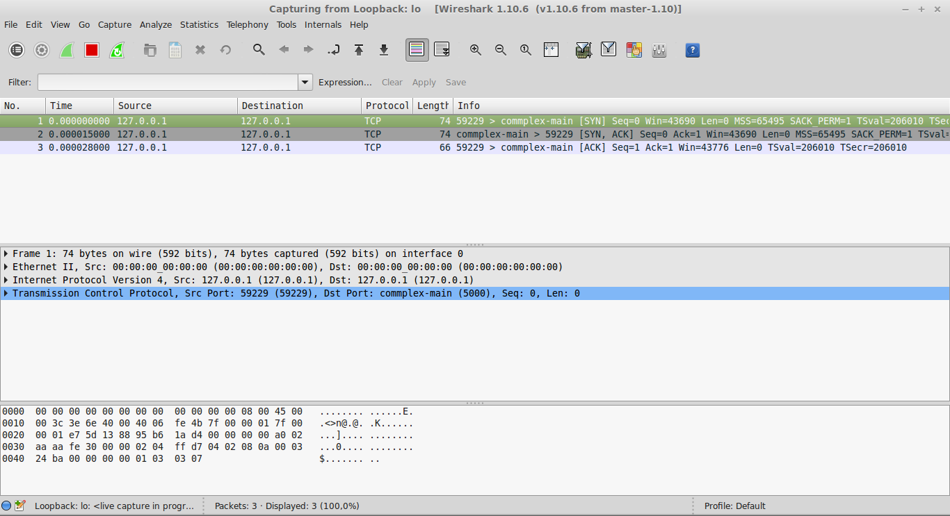
Tampilan Wireshark pada Program Select: Inisialisasi

Slide 21
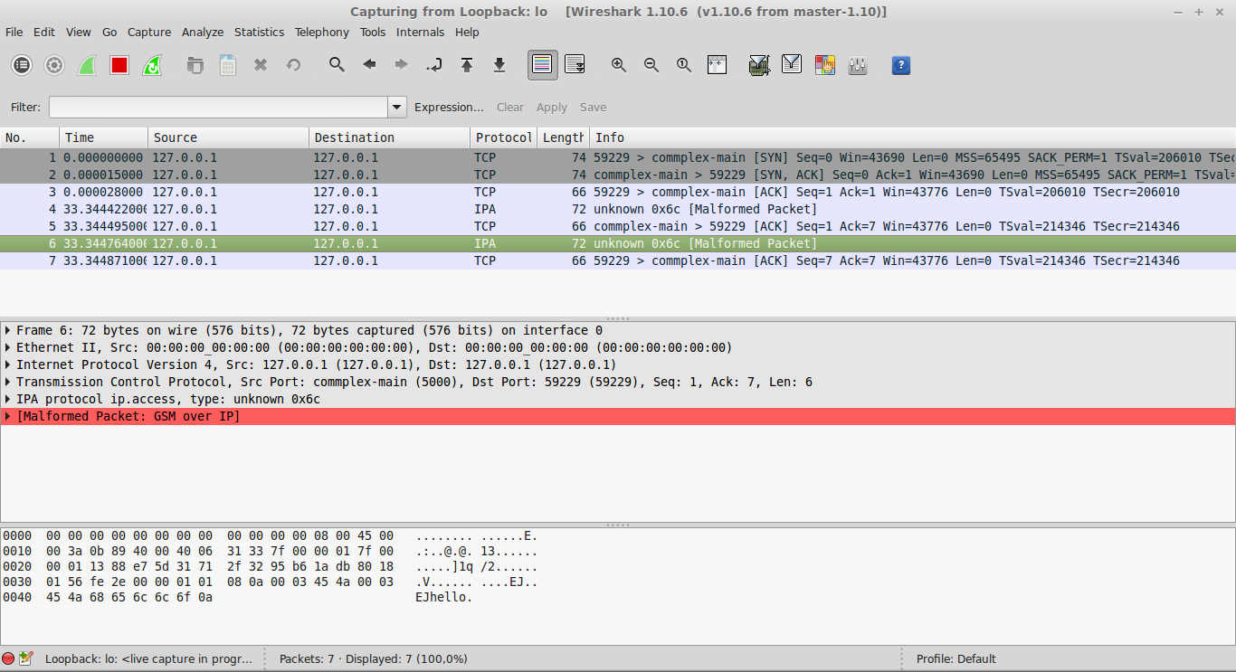
Tampilan Wireshark pada Program Select: Klien Mengirim Data

Slide 22
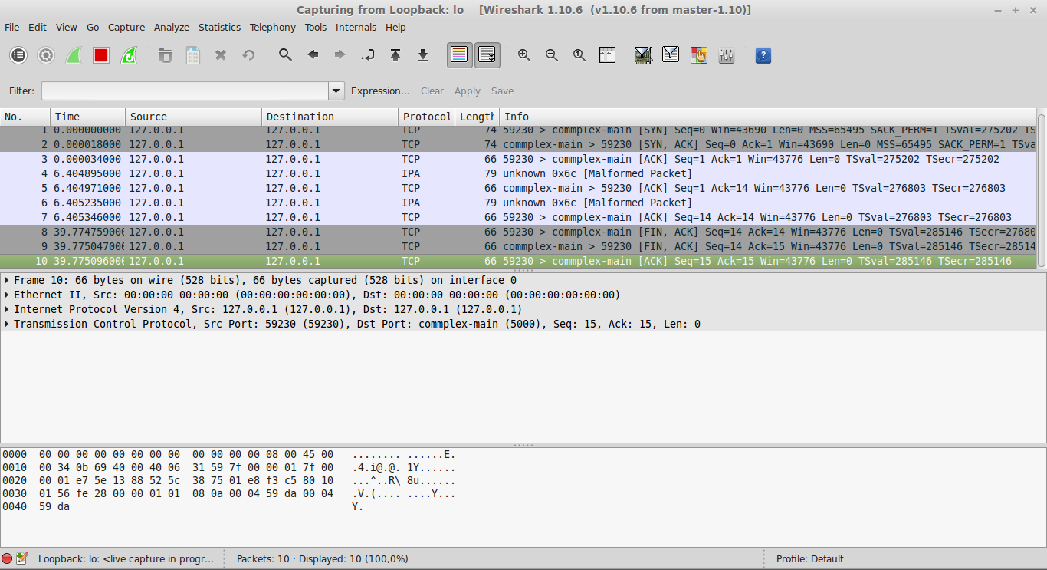
Tampilan Wireshark pada Program Select: Klien Menutup Koneksi

Slide 23
SocketServer
A framework for network servers
The socketserver module simplifies the task of writing network servers
There are four basic concrete server classes:
TCPServer
UDPServer
UnixStreamServer
UnixDatagramServer
https://docs.python.org/3/library/socketserver.html

Slide 24
SocketServer
These four classes process requests synchronously; each request must be completed before the next request can be started.
This isn’t suitable if each request takes a long time to complete (a lot of computation, or a lot of data).
The solution is to create a separate process or thread to handle each request; the ForkingMixIn and ThreadingMixIn mix-in classes can be used to support asynchronous behaviour.

Slide 25
Socket shutdown
“half-close” the socket
To shut down communication permanently in one direction without destroying the socket itself.
In this state, the server can no longer read any data, but it can still send any remaining reply back in the other direction, which will still be open.

Slide 26
Socket shutdown
SHUT_WR: This value says that the caller will be writing no more data into the socket and that reads from its other end should respond that there is no more data and indicate end-of-file.
SHUT_RD: This is used to turn off the incoming socket stream so that an end-of-file error is encountered if your peer tries to send any more data to you on the socket.
SHUT_RDWR: This closes communication in both directions on the socket.

Slide 27
framing
How to delimit your messages so that the receiver can tell where one message ends and the next one begins
The program that receives the message might have to make several recv() calls before your whole message has been read

Slide 28
Framing 1: socket close
The sender can loop until all of the outgoing data has been passed to sendall() and then close() the socket.
The receiver need only call recv() repeatedly until the call finally returns an empty string indicating that the sender has finally closed the socket.

Slide 29
Framing 2: streaming in both directions
First, data is streamed in one direction. Then that one direction is shut down.
Second, data is then streamed in the other direction, and the socket is finally closed.
An important warning: always finish the data transfer in one direction before turning around to stream data back in the other

Slide 30
Framing 3: use fix-length message
Use fixed-length messages
Use the Python sendall() method to transmit your byte string and then use a recv() loop of your own devising to make sure that you receive the whole message.

Slide 31
Framing 4: use delimiter
Delimit your messages with special characters.
The receiver would wait in a recv() loop like the one just shown but not exit the loop until the reply string it was accumulating finally contained the delimiter indicating the end-of-message.
If the message can include arbitrary data, then using a delimiter is a problem.

Slide 32
Framing 5: use prefix or header
Prefix each message with its length
This is a popular choice for high-performance protocols since blocks of binary data can be sent verbatim without having to be analyzed, quoted, or interpolated.
The length is given as a simple fixed-width binary integer or else a variable-length decimal string followed by a textual delimiter.

Slide 33
Framing 6:
Instead of sending just one, try sending several blocks of data that are each prefixed with their length.
This means that as each chunk of new information becomes available to the sender, it can be labeled with its length and placed on the outgoing stream.
When the end finally arrives, the sender can emit an agreed-upon signal—perhaps a length field giving the number zero—that tells the receiver that the series of blocks is complete.

Slide 34
Referensi Source Code Progjar
https://github.com/studiawan/network-programming
https://github.com/brandon-rhodes/fopnp/tree/m/py3
https://github.com/PacktPublishing/Python-Network-Programming-Cookbook-Second-Edition
https://github.com/PacktPublishing/Python-Network-Programming
https://github.com/PacktPublishing/Learning-Python-Networking-Second-Edition
https://github.com/PacktPublishing/Mastering-Python-Networking-Third-Edition
https://github.com/PacktPublishing/Python-Networking-Cookbook
https://github.com/PacktPublishing/Mastering-Python-for-Networking-and-Security-Second-Edition

Slide 35
Terima kasih

